Slide 1



Alamo Colleges
Foundation Scholarships

Slide 2

Alamo Colleges Foundation
We are the philanthropic arm of the Alamo Colleges.
Our focus is on raising money
for student scholarships —
these are life-changing gifts that
helps you come in and stay in,
helping you to achieve your dreams of a college education.

Slide 3



FOUNDATION SCHOLARSHIP IMPACT BY YEAR
In calendar year 2024,
2380 distinct students were awarded Foundation Scholarships
The average award amount per student was $1193

Slide 4

2025-2026 Foundation Scholarship Cycle
Application Opens
Jan 15, 2025
Application Closes
May 15, 2025
Review Process
May 17- May 29, 2025
Awarding Begins
June 1, 2025

Slide 5



Scholarships @ Alamo Colleges
Each academic year has one General Foundation Scholarship application cycle
The General Application opens January 15, 2025 and closes May 15, 2025. (Fall 2025, Spring 2026, and/or Summer 2026 awards)
You must submit an application every academic year to be considered.
Some scholarships require financial need. You should submit the 2025-2026
Free Application for Federal Student Aid (FAFSA) at https://studentaid.gov as soon as possible to ensure their application is complete for reviewing any need-based requirements.
Awards can be used at any of the Alamo Colleges (SAC, SPC, PAC, NVC, NLC), however some awards are tied to the Home Campus listed on their admissions record.

Slide 6

Alamo Colleges Foundation Scholarship Application
Applicants must have an Alamo ACES account to apply!
You will be asked to share academic, personal, and professional information.
Questions are provided to determine eligibility for all opportunities
You can write about your Honors, Recognitions, Military Service, Employment, Family Duties or Extracurricular Activities.
We want to know your story!
One application for ALL opportunities

Slide 7
Alamo Colleges Foundation Scholarship Review
Scholarship judges or selection committees review and score scholarship applications.
Judges/committee members are composed of faculty, staff, and/or community representatives.
Rating points are given to each applicant for responses to essay questions.
Selections are based on the applicant meeting scholarship criteria and the points given by scholarship judges/selection committees.
Specific criteria may include GPA, major, Home Campus, leadership skills, community service, employment and/or extracurricular activities.

Slide 8
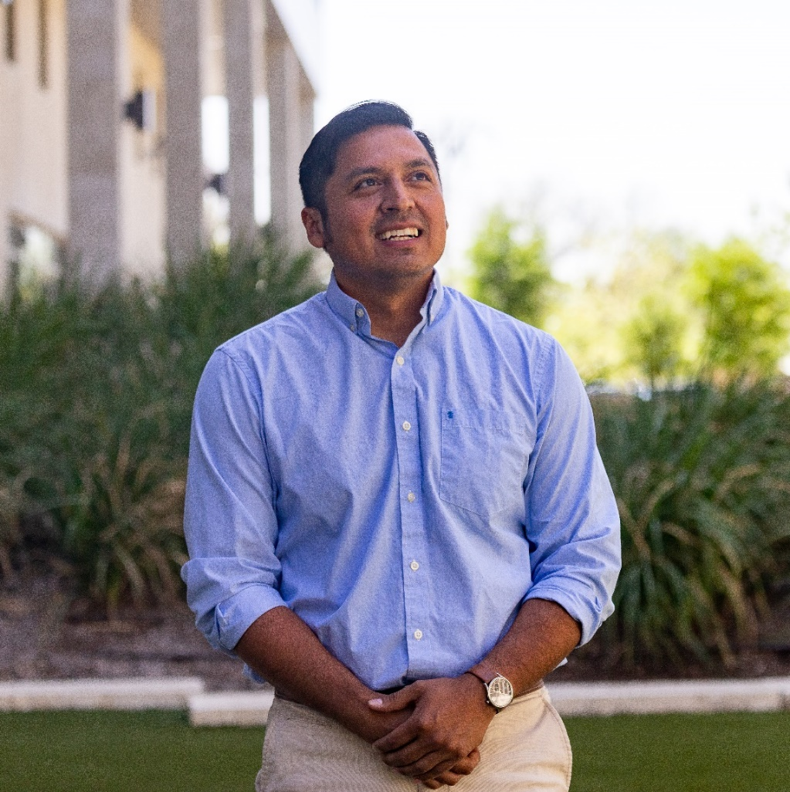
Alamo Colleges Foundation Scholarship Acceptance
Selected students are notified through Alamo ACES email
Recipients are asked to accept the award & complete a ‘Thank You Letter' to the donors
Alamo Colleges Foundation monitors students to ensure they meet the standards of academic progress and scholarship requirements.
The Foundation hosts receptions and events, creating opportunities to meet donors and other scholarship students!

Slide 9

Accessing the General Scholarship Application
You can access the
scholarship application
on our website:
https://www.alamo.edu/foundation/scholarships

Slide 10
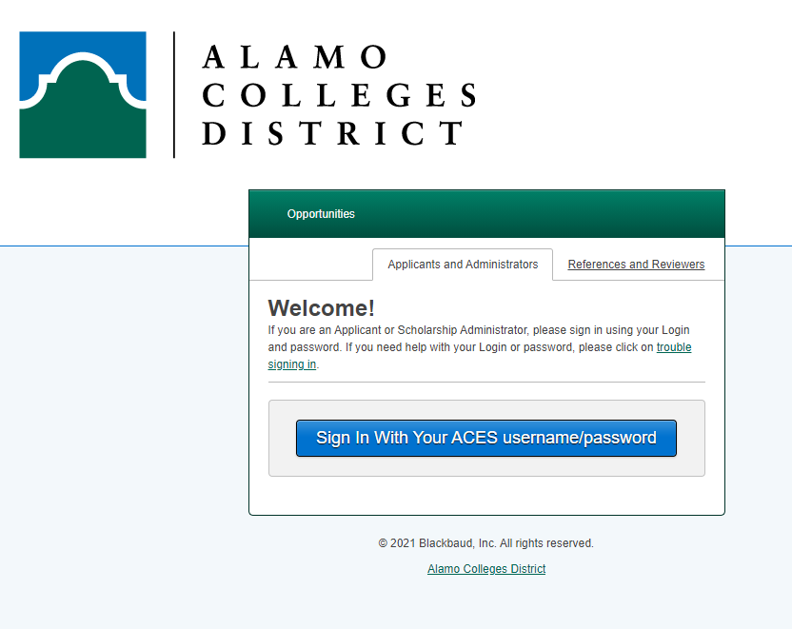
Accessing the General Scholarship Application
Sign in with your ACES User ID and Password
If you do not know your ACES login information, please call the Helpdesk at 210-485-0555.

Slide 11
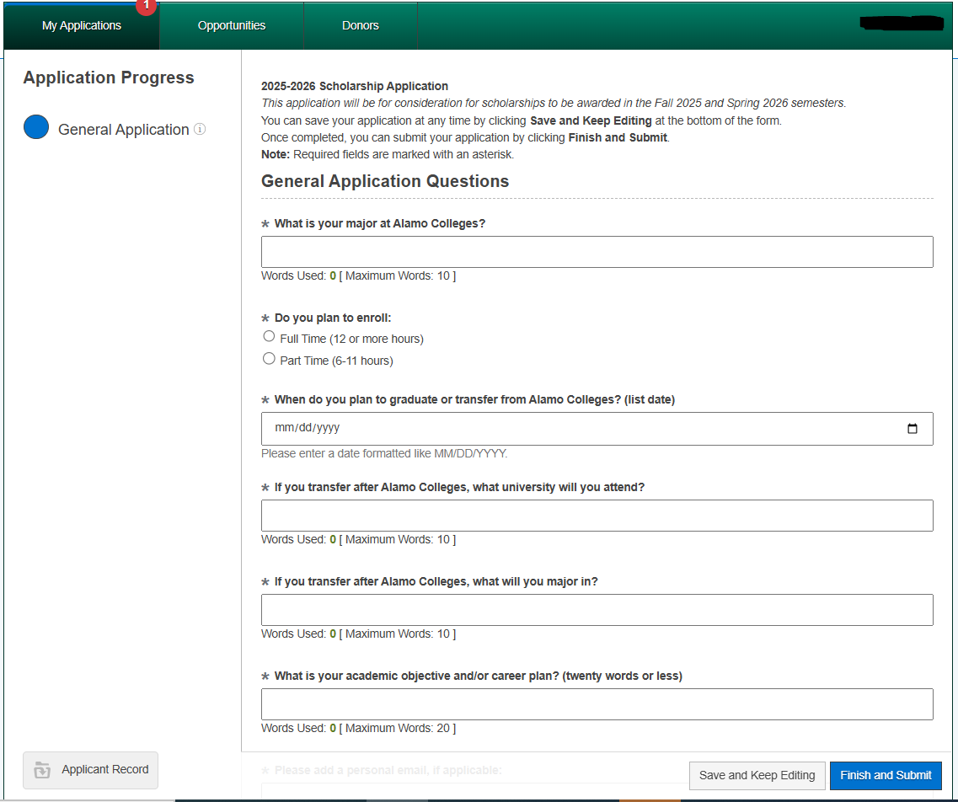
Completing the General Scholarship Application
Once logged in, you may begin completing the General Application
You will also be asked to complete several supplemental questions. (Yes/No answers)

Slide 12
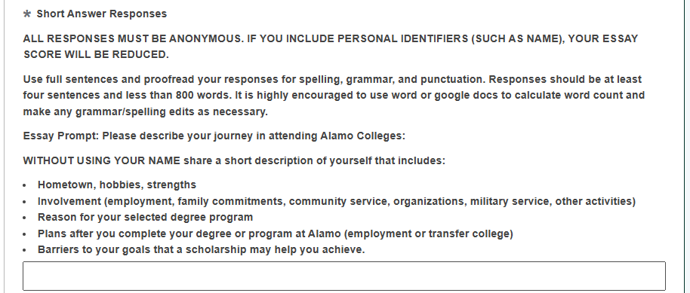
Completing the General Scholarship Application
You will also be asked to complete a short answer essay question

Slide 13
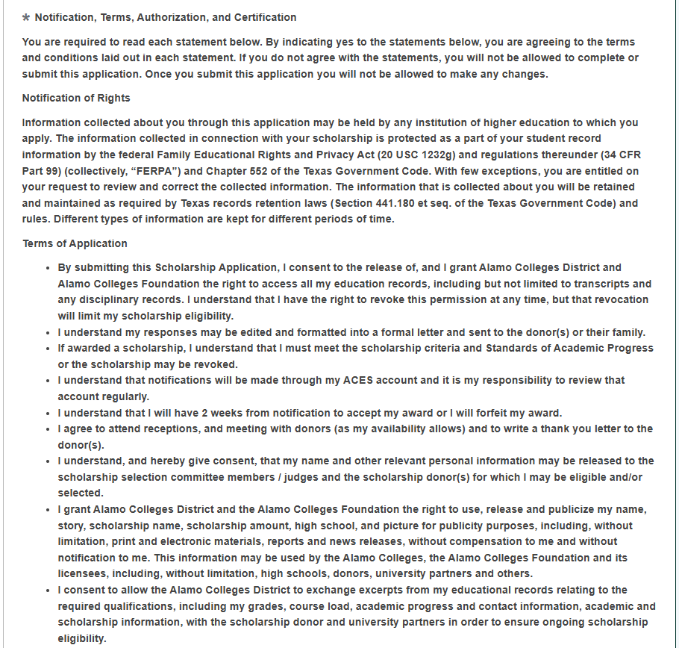
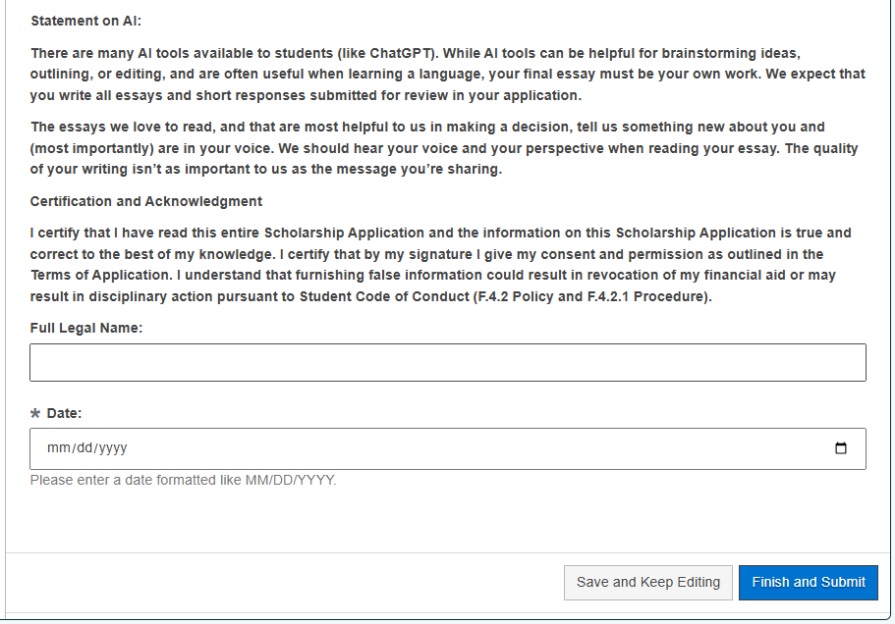
Completing the General Scholarship Application
Once you have answered all questions, you will be asked to certify your application.
Click the ‘Finish and Submit' button.
If you need more time to complete, select the Save and Keep Editing to come back at a later time.

Slide 14
What happens now?
After submitting your application, you will receive a confirmation email from
dst-scholarship@alamo.edu
to know we have received your application.
Students that apply by the May deadline will be eligible for the first awarding cycle. Students applying after May 15 will be eligible for limited opportunities.
Scholarship selections are based on the applicant meeting the minimum scholarship criteria and the points given by scholarship judges/selection committees.
Applications meeting the Priority Date will start receiving notifications concerning awards as early as June 1, 2025.
you will be given instructions and timeframes to accept your award (typically two weeks from notification). We encourage you to check your ACES email regularly!

Slide 15
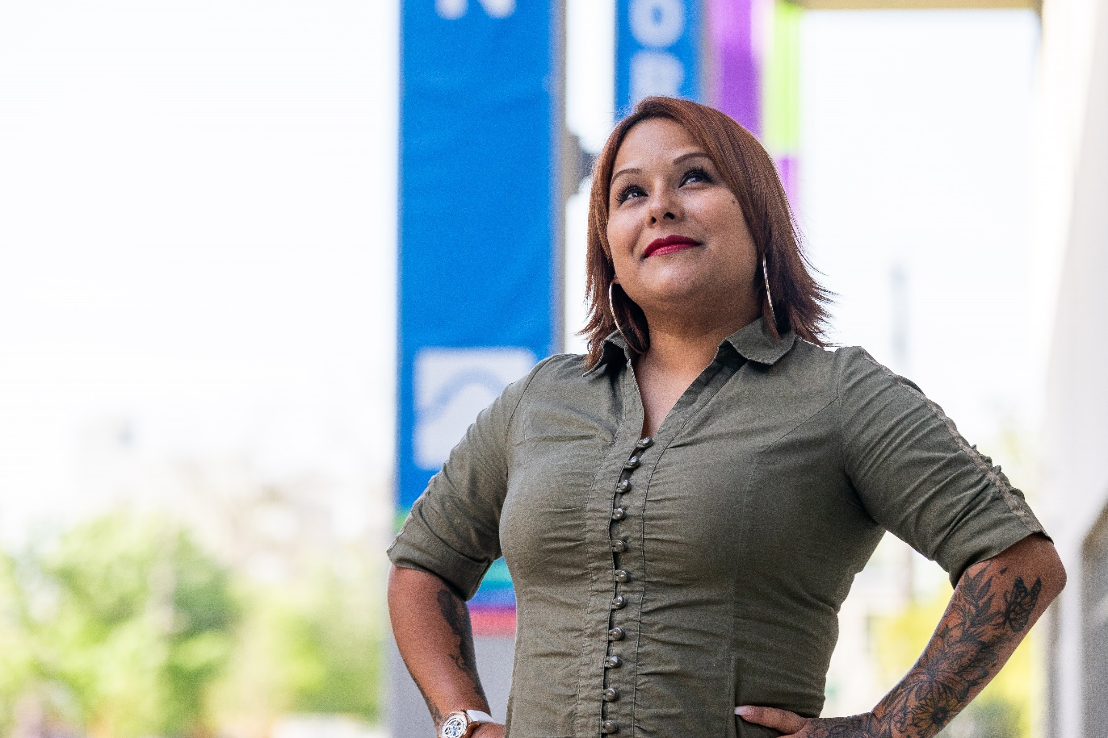



Let’s Stay Connected!
Follow Us for the latest news and announcements!
@alamocollegesfd
@AlamoCollegesFd
@AlamoCollegesFoundation
Find more information and
application links online at http://alamo.edu/foundation

Slide 16
Thank you.

